Slide 1
Building Qt5 Uis with the MachinekitSDK
Alexander Rössler

Slide 2
Overview
Vagrant
QtQuickVcp
SDK
Future

Slide 3
What is Vagrant?

Slide 4

Vagrant
Easy to configure
Reproducible
Portable
"works on my machine" bugs

Slide 5

Virtual Machine
VirtualBox
Jessie
LXDE
Machinekit packages
Qt SDK
Git repostories

Slide 6
QtQuickVcp

Slide 7

QtQuickVcp
QtQuick 2
QML plugins
Machinetalk
Cross platform

Slide 8
Remote Launching & Deployemnt
Start new instances
Deploy UI files
MachinekitClient

Slide 9
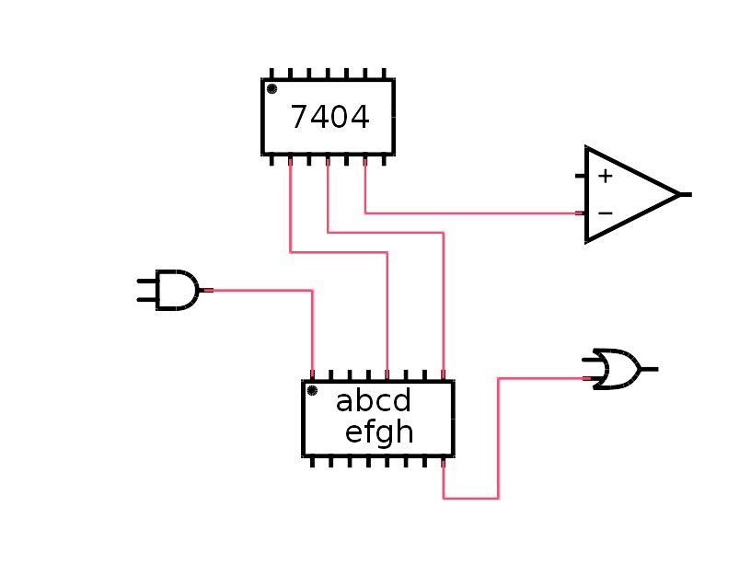

User Interfaces
2 types of user interfaces
  HAL Remote
  Application/EMC

Slide 10
SDK

Slide 11
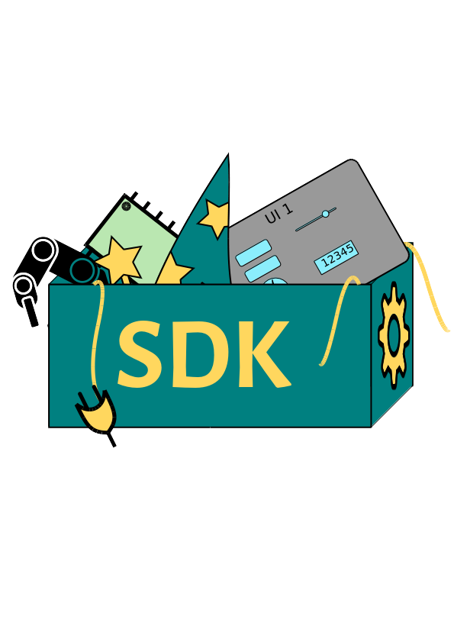
Machinekit SDK
Wizards
Plugins
Templates
Qt Creator

Slide 12
Future

Slide 13

Ideas
Develop HAL in SDK
Simulate in VM
Remote deploy and run
More wizards

Slide 14

Ideas
Graphical HAL editor
Live editing
SW/HW co-design
HAL component store

Slide 15

More Information and Code
https://github.com/strahlex/machinekit-vagrant
https://github.com/strahlex/MachinekitSDK
https://github.com/strahlex/QtQuickVcp

Slide 16
Questions?

